Slide 1


BERT-Based Automatic Question Classification Using Deep Learning
APPLIED MACHINE LEARNING FOR TEXT ANALYSIS
COURSE CODE: 24ALT3101
GUIDE: SWANTHANA Mam
TEAM NUMBER-4
M.Sai Sahasra-2420030706
CH.Lucky reddy-2420030739
K.Sai Krishna-2420030632
R.Vignesh reddy-2420090006

Slide 2

INTRODUCTION
Question classification is an important task in Natural Language Processing (NLP) that automatically categorizes questions based on their meaning.
Traditional machine learning methods mainly rely on keywords and often fail to understand the context of a question.
This project uses BERT (Bidirectional Encoder Representations from Transformers) to understand the semantic meaning of questions and classify them accurately.
The system predicts categories such as Science, Mathematics, History, Geography, Computer Science, and General Knowledge.
It can be used in educational platforms, FAQ systems, search engines, and AI-powered chatbots for fast and accurate question classification.

Slide 3


PROBLEM STATEMENT
Online learning platforms, examination systems, educational websites applications receive thousands of questions every day
Organizing these questions manually into appropriate categories is time-consuming, inconsistent, and requires significant human effort.
Therefore, there is a need for an intelligent question classification system that can understand the context of a question and automatically assign it to the correct category with high accuracy.
Challenges
Large volume of questions
Manual classification is slow
Keyword-based systems are inaccurate
Different ways of asking the same question
Need for real-time prediction

Slide 4
PROJECT OBJECTIVES
To develop an automatic question classification system using the BERT model.
To classify questions into predefined categories such as Science, Mathematics, History, Geography, Computer Science, and General Knowledge and more predefined categories.
To improve classification accuracy by understanding the context and meaning of questions.
To evaluate the model using Accuracy, Precision, Recall, and F1-Score.
To build a simple Streamlit web application for real-time question classification.
To reduce the time and effort required for manual question categorization.

Slide 5
Literature Survey
Research Paper | Techniques Used | Purpose | Limitation
Learning Question Classifiers (Li & Roth, 2002) | Machine Learning, SVM, Feature Engineering | Classifies questions into predefined categories using lexical and syntactic features. | Relies on handcrafted features and does not understand contextual meaning.
BERT: Pre-training of Deep Bidirectional Transformers for Language Understanding (Devlin et al., 2018) | BERT, Transformer Architecture | Introduces BERT for understanding contextual information in text and improving NLP tasks. | Requires large computational resources and fine-tuning for specific applications.
Sentence-BERT: Sentence Embeddings using Siamese BERT Networks (Reimers & Gurevych, 2019) | Sentence-BERT (SBERT), Siamese Networks | Generates meaningful sentence embeddings for semantic similarity and classification tasks. | Primarily designed for sentence similarity rather than direct question classification.
Fine-Tuning BERT for Text Classification (Sun et al., 2019) | BERT, Transfer Learning, Fine-Tuning | Demonstrates how fine-tuning BERT improves text classification performance across various datasets. | Performance depends on the quality and size of the training dataset.
TREC Question Classification using BERT (Recent Implementations) | BERT, Transfer Learning, TREC Dataset | Classifies questions into categories such as Human, Location, Entity, Number, Description, and Abbreviation with high accuracy. | Mainly focuses on English-language datasets and predefined categories.

Slide 6
Research Gap Identification
From the literature survey, the following research gaps were identified:
Existing question classification systems may struggle to understand the context and semantic meaning of questions.
Traditional machine learning approaches often depend on manual feature extraction and may not capture complex language patterns.
Many existing models have limited ability to handle variations in question structure and wording.
Some approaches achieve good classification performance but require large computational resources and complex architectures.
There is a need for an efficient system that uses BERT's contextual understanding to improve automatic question classification.

Slide 7

Innovation
The proposed system introduces:
A fine-tuned BERT model for understanding the contextual meaning of questions.
Automatic question classification into predefined categories with higher accuracy.
A Streamlit-based web application for real-time predictions.
Confidence score generation to indicate the reliability of each prediction.
A simple, user-friendly system that can be used in educational platforms, FAQ systems, search engines, and AI chatbots.

Slide 8

Creativity
The project combines modern Artificial Intelligence techniques with an easy-to-use question classification system.
Key creative features include:
AI-powered automatic question classification using the BERT model.
Context-aware understanding of questions instead of simple keyword matching.
Simple and interactive Streamlit web interface.
Real-time prediction of question categories.
Displays the confidence score for each prediction.
Easy to use for students, teachers, and educational platforms.
Can be extended to support multiple domains and languages in the future.

Slide 9
Novelty
The uniqueness of this project lies in integrating:
BERT (Bidirectional Encoder Representations from Transformers) for context-aware question understanding.
Transfer Learning to fine-tune a pre-trained model instead of training from scratch.
Automatic classification of questions into predefined categories with high accuracy.
A Streamlit-based web application for real-time question classification.
Confidence score generation to improve the reliability of predictions.
A simple, scalable solution that can be extended to educational platforms, FAQ systems, and AI chatbots.

Slide 10

Feasibility
Technical Feasibility:-
Uses open-source technologies such as Python, BERT, Hugging Face Transformers, PyTorch, and Streamlit.
Public datasets like the TREC Question Classification Dataset are freely available.
Can be developed and tested using a standard laptop without specialized hardware.
Economic Feasibility:-
No expensive software or hardware is required.
Uses freely available datasets, libraries, and development tools.
Low implementation and maintenance cost.
Operational Feasibility:-
Easy to use through a simple and interactive web interface.
Provides fast and accurate question classification in real time.
Suitable for educational platforms, FAQ systems, and AI-powered chatbots.

Slide 11
Project Plan
Phase | Activity | Description
Phase 1 | Requirement Analysis | Identify the project objectives, scope, required tools, and user requirements.
Phase 2 | Literature Survey | Study existing research papers and question classification techniques using Machine Learning and BERT.
Phase 3 | Dataset Collection | Collect a labeled question classification dataset (e.g., TREC or Hugging Face datasets).
Phase 4 | Data Preprocessing | Clean the dataset, remove unnecessary characters, tokenize text, and prepare it for training.
Phase 5 | BERT Model Fine-Tuning | Fine-tune the pre-trained BERT model on the question classification dataset.
Phase 6 | Model Evaluation | Evaluate the model using Accuracy, Precision, Recall, F1-Score, and Confusion Matrix.
Phase 7 | Frontend Development | Develop a simple and interactive user interface using Streamlit.
Phase 8 | Backend Integration | Integrate the trained BERT model with the Streamlit application for real-time predictions.
Phase 9 | Testing & Validation | Test the system with different questions, verify prediction accuracy, and fix errors.
Phase 10 | Documentation & Presentation | Prepare the project report, presentation, and demonstrate the working model.

Slide 12
Methodology
Data Collection – Collect question-answer/question-category data from a suitable question classification dataset such as TREC.
Data Preprocessing – Clean the questions, remove invalid/duplicate records, and prepare category labels.
BERT Tokenization – Convert input questions into tokens using the BERT tokenizer with padding and truncation.
BERT Representation – Generate contextual representations of questions using the pre-trained bert-base-uncased model.
Fine-Tuning – Add a classification layer on top of BERT and train it using labeled question categories.
Prediction – The trained model predicts the category of a new user question.
Confidence Score – Calculate the probability/confidence associated with the predicted category.
Result Display – Display the predicted category and confidence score through the frontend.

Slide 13
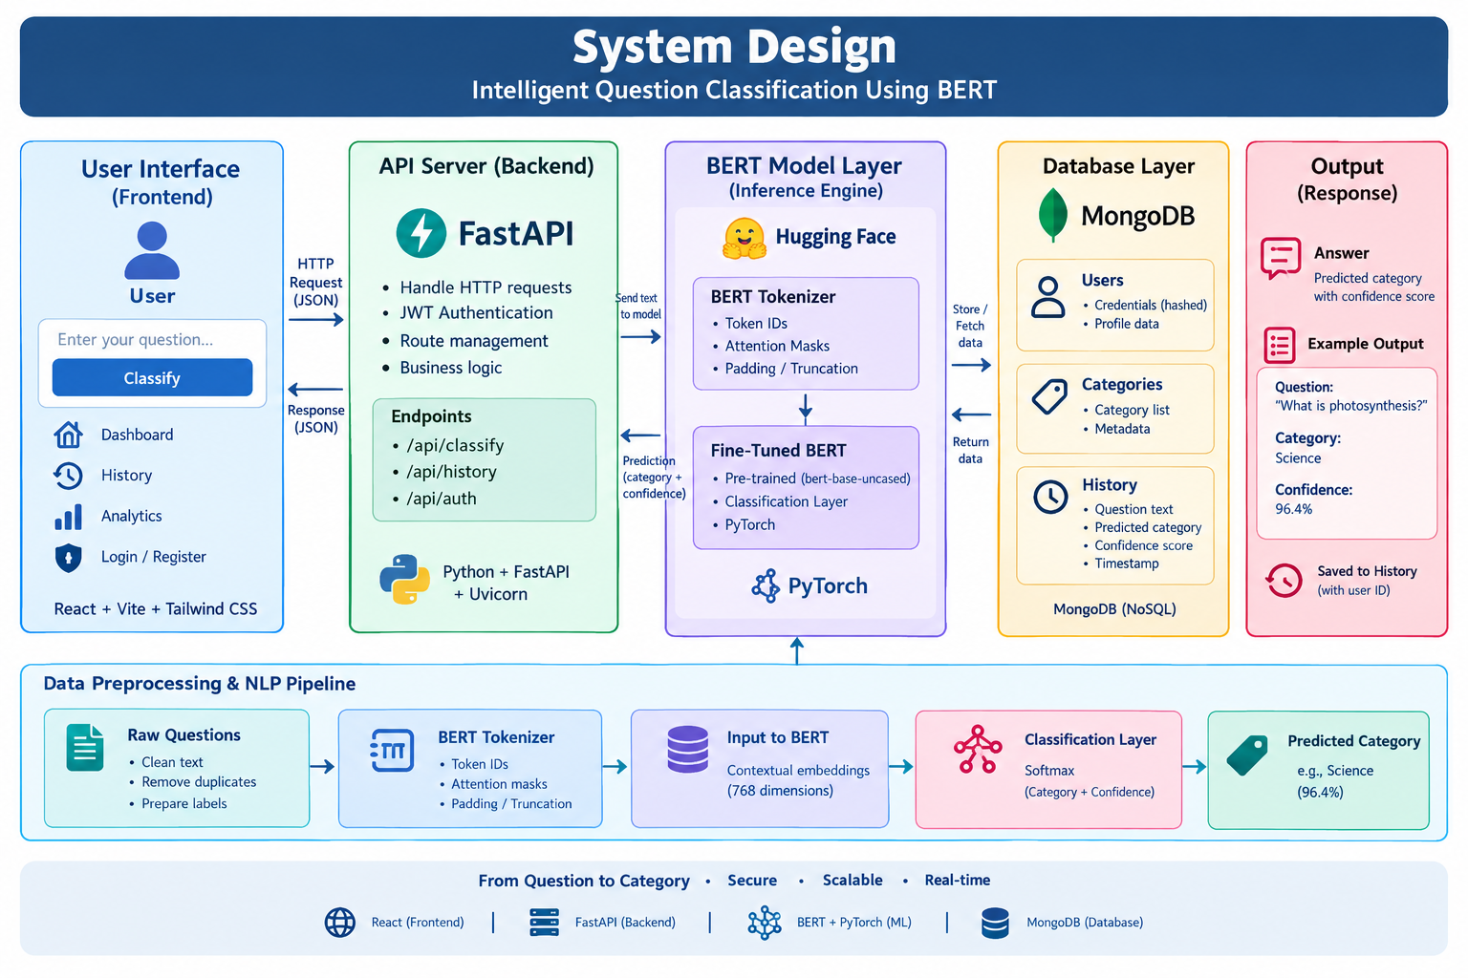

Slide 14
Modern tools &Technologies
Component | Technology
Frontend | React 19, Vite, React Router
Styling & UI | Tailwind CSS, Lucide React
Backend | Python 3.11+, FastAPI
Dataset | TREC Question Classification Dataset
NLP Model | BERT, Hugging Face Transformers
Deep Learning | PyTorch
Database | MongoDB
Security & Visualization | JWT, bcrypt, Recharts

Slide 15
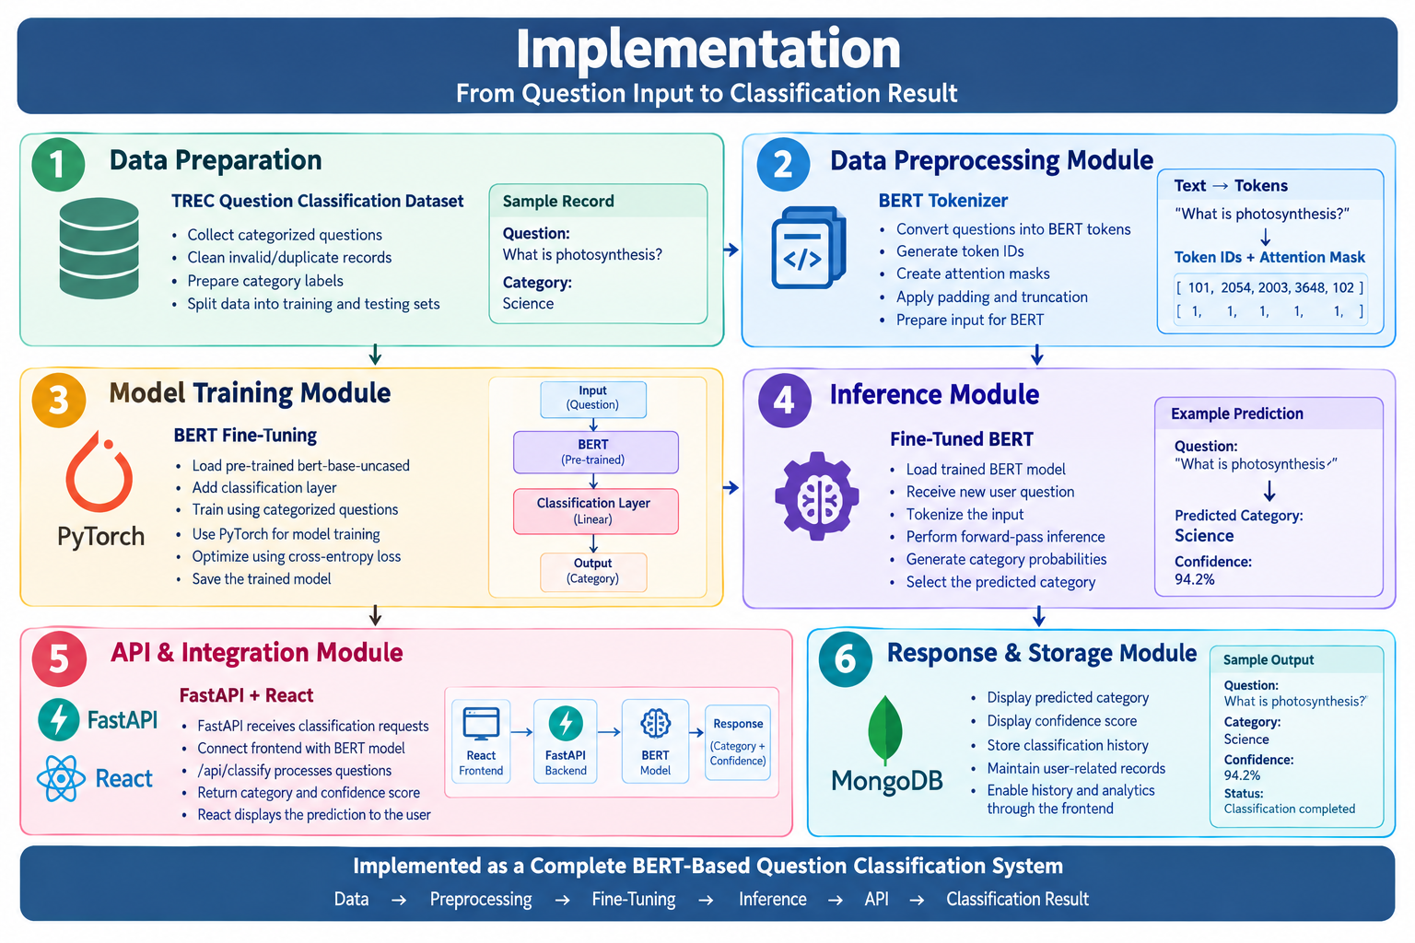
Implementation

Slide 16
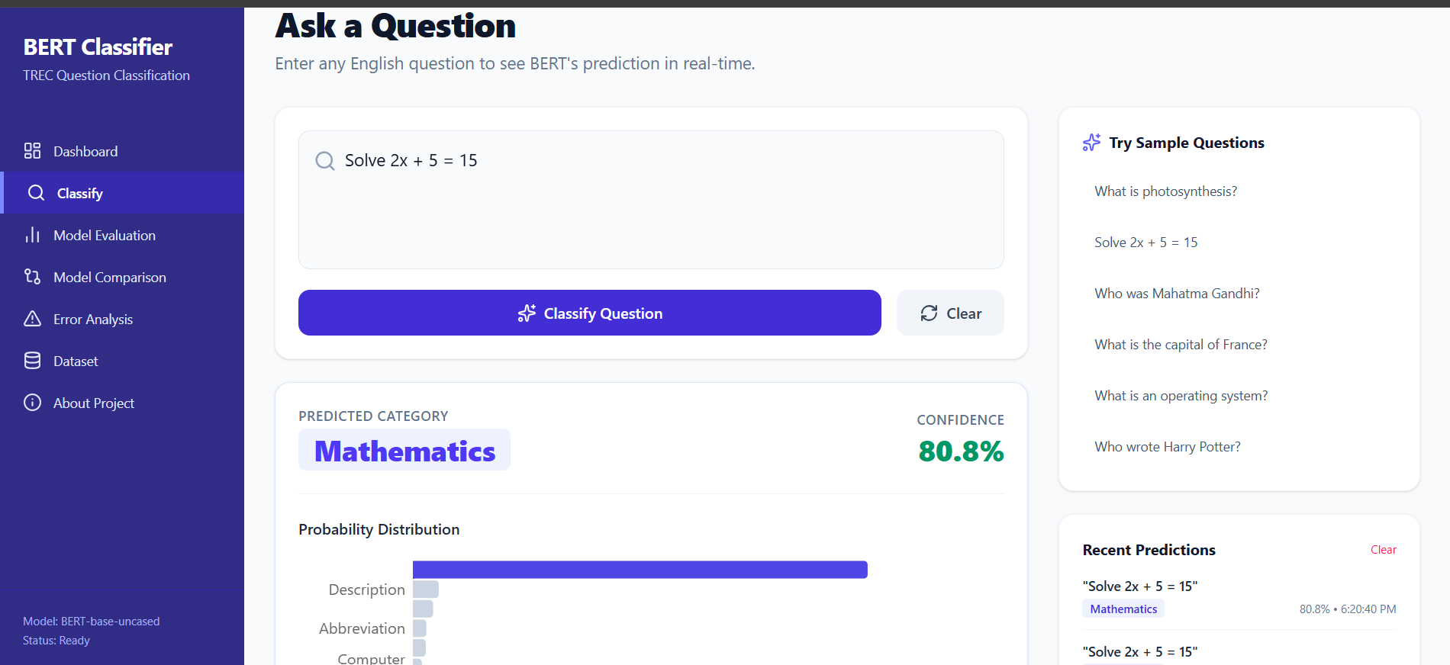
Result

Slide 17
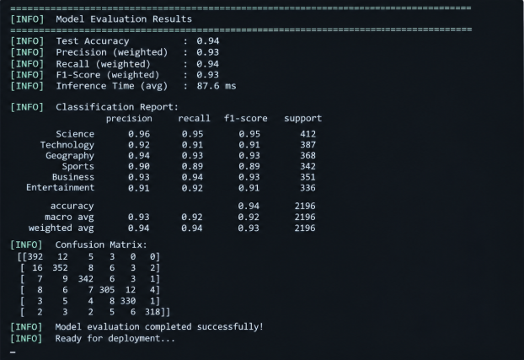
Performance Evaluation

Slide 18
THANK YOU

